Slide 1
CSE202: OBJECT ORIENTED PROGRAMMING
Static Members and Static Functions
Friend Function and Friend Class
Functions
Recursion

Slide 2
Memory allocation for objects
We have studied that memory space for objects is allocated when they are declared and not when class is specified. All objects belong to a class use same member functions no separate space is allocated for member function when object is created.
Only space for member variables is allocated separately for each object.
Memory created when functions defined: common
Memory created when objects defined. Not common

Slide 3
Static Data Members
It is initialized to zero when first object of its class is created . No other initialization is permitted.
Only one copy of that member is created for entire class and shared by all objects of that class.
They are normally used to maintain values common to the entire class
Example: static data member can be used as a counter that records the occurrences of all objects
Type and scope of each static member variable must be defined outside the class definition.
This is necessary because static data members are stored separately rather than as a part of an object.
Since they are associated with the class itself rather than with any class object, they are also known as class variables.

Slide 4
Static data member
class item
{ static int count;
int number;
public:
void getdata(int d)
{ number = d;
count++;
}
void getcount()
{
cout<<count;
}
};
int item :: count; // definition of static data member
main(){
item a,b,c;
a.getcount();
b.getcount();
c.getcount();
a.getdata(100);
b.getdata(200);
c.getdata(300);
cout<<“ after reading”;
a.getcount();
b.getcount();
c.getcount();
} OUTPUT
Count:0 0 0
After reading 3 3 3

Slide 5
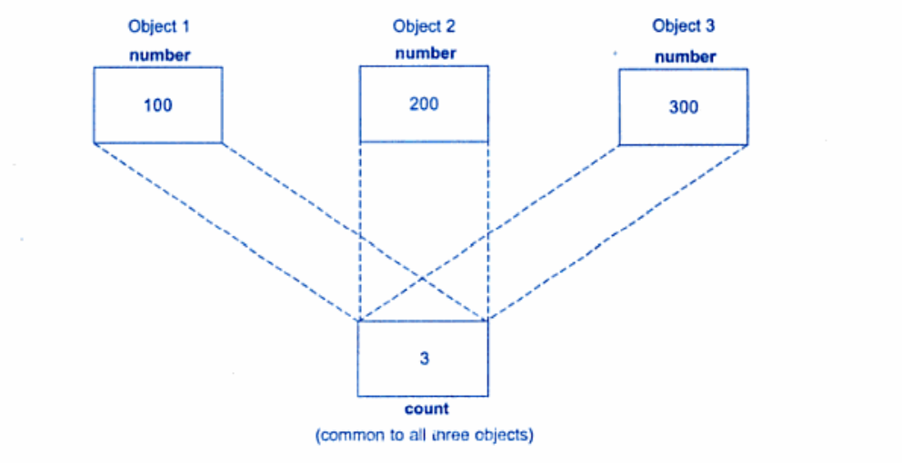
Static data member(count)

Slide 6
Static member function
A static function can have access to only static members declared in same class
Can be called using class name instead of objects
class-name :: function-name;

Slide 7
class test
{
int code;
static int count;
public:
void setcode()
{
code= ++count;
}
void showcode()
{
cout<<"Code: "<<code<<endl;
}
static void showcount()
{
cout<<"Count: "<<count<<endl;
}
};
int test :: count;
int main()
{
test t1,t2;
t1.setcode();
t2.setcode();
test :: showcount();
test t3;
t3.setcode();
test:: showcount();
t1.showcode();
t2.showcode();
t3.showcode();
}

Slide 8
True statements about static member function is/are
(I)Static function of a class can be called by class name using scope resolution operator i.e. : :
(II)Static function can receive both static and non-static data members of a class
(III)Static function is not the part of an object of a class
I and II
I only
I and III
I, II and III

Slide 9
True statements about static member function is/are
(I)Static function of a class can be called by class name using scope resolution operator i.e. : :
(II)Static function can receive both static and non-static data members of a class
(III)Static function is not the part of an object of a class
I and II
I only
I and III
I, II and III

Slide 10
Which function can be called without using an object of a class in C++
Static function
Inline function
Friend function
constant function

Slide 11
Which function can be called without using an object of a class in C++
Static function
Inline function
Friend function
constant function

Slide 12
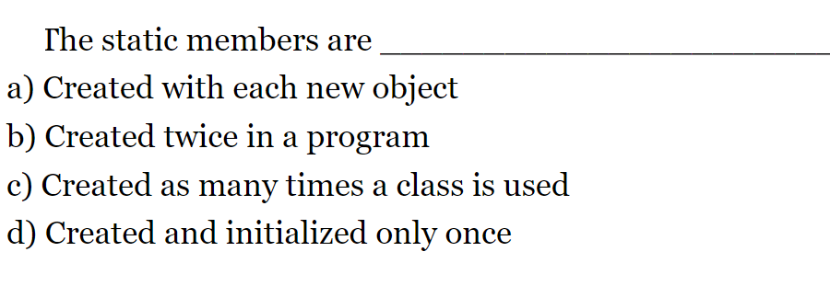
Notes:
Ans d

Slide 13
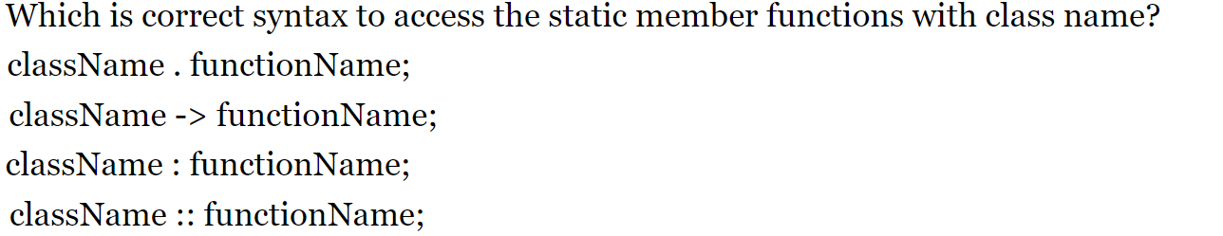
Notes:
Ans d

Slide 14
Friend Functions and Friend Classes
Data hiding is a fundamental concept of object-oriented programming. It restricts the access of private members from outside of the class.
Similarly, protected members can only be accessed by derived classes and are inaccessible from outside.
However, there is a feature in C++ called friend functions that break this rule and allow us to access member functions from outside the class.
Similarly, there is a friend class as well, which we will learn later
friend function of a class
  Defined outside that class’s scope.
  Not a member function of that class.
  has the right to access the non-public and public members of that class.
  Standalone functions or entire classes may be declared to be friends of a class.
  Can enhance performance.
  Often appropriate when a member function cannot be used for certain operations.

Slide 15
friend Function in C++
A friend function can access the private and protected data of a class. We declare a friend function using the friend keyword inside the body of the class.
class className
{
... .. ...
friend returnType functionName(arguments);
... .. ...
}

Slide 16
A friend function possesses certain special characteristics:
It is not in the scope of the class to which it has been declared as friend.
Since it is not in the scope of the class, it cannot be called using the object of that class.
It can be invoked like a normal function without the help of any object.
Unlike member functions, it cannot access the member names directly and has to use an object name and dot membership operator with each member name (e.g., A.x)
It can be declared either in public or private part of a class without affecting its meaning.
Usually, it has the objects as arguments.

Slide 17
class sample
{
int a,b;
public:
void setvalue() { a=10; b=40; }
friend float mean (sample s);
};
float mean(sample s)
{
return float(s.a + s.b)/2;
}
main()
{
sample x;
x.setvalue();
cout<<“mean is”<< mean(x);
}

Slide 18
Where does keyword ‘friend’ should be placed?
A. function declaration
B. function definition
C. main function
D. block function

Slide 19
Where does keyword ‘friend’ should be placed?
A. function declaration
B. function definition
C. main function
D. block function

Slide 20
Example 2: Add Members of Two Different Classes
// Add members of two different classes using friend functions
#include <iostream>
using namespace std;
// forward declaration
class ClassB;
class ClassA {
private:
int a;
public:
void ipa() { a=10;}
// friend function declaration
friend int add(ClassA, ClassB);
}A;
class ClassB {
private:
int b;
// friend function declaration
friend int add(ClassA, ClassB);
public:
void ipb() {b=20;}
}B;
// access members of both classes
int add(ClassA objectA, ClassB objectB) {
int s;
s=objectA.a + objectB.b;
return (s);
}
main() {
A.ipa(); B.ipb();
cout << "Sum: " << add(A,B);
}

Slide 21
Which of the following is correct about friend functions?
A. Friend functions use the dot operator to access members of a class using class objects
B. Friend functions can be private or public
C. Friend cannot access the members of the class directly
D. All of the above

Slide 22
Which of the following is correct about friend functions?
A. Friend functions use the dot operator to access members of a class using class objects
B. Friend functions can be private or public
C. Friend cannot access the members of the class directly
D. All of the above

Slide 23
A friend function can be
A. A method of another class
B. A global function
C. Both A and B
D. None of the above

Slide 24
A friend function can be
A. A method of another class
B. A global function
C. Both A and B
D. None of the above

Slide 25
Function friendly to two classes
# include<iostream>
using namespace std;
class ABC; //forward declaration
class XYZ
{
int x;
public:
void setvalue(int i) { x=i;}
friend void max(XYZ, ABC);
};
class ABC
{
int a;
public:
void setvalue(int i) { a=i;}
friend void max(XYZ, ABC);
};
void max(XYZ m, ABC n) //Definition of friend
{
if(m.x>= n.a)
cout<<m.x;
else
cout<<n.a;
}
int main()
{
ABC abc;
abc.setvalue(10);
XYZ xyz;
xyz.setvalue(20)
max(xyz,abc);
return 0;
}
OUTPUT:
20

Slide 26
Swapping Private data of classes
# include<iostream>
using namespace std;
class class_2;
class class_1
{
int value1;
public:
void intdata(int a) { value1=a;}
void display(void) { cout<<value1<<‘\n”; }
friend void exchange(classes_1 &, classes_2 &);
};
void exchange(class_1 & x, class_2 & y)
{
int temp = x.value1;
x.value1 = y.value2;
y.value2 = temp;
}
int main()
{
class_1 C1;
class_2 C2;
C1.indata(100);
C2.indata(200);
cout<<“Values before exchange”<“\n”;
C1.display();
C2.display();
exchange(C1,C2); //swapping
cout<<“values after exchange”<<“\n”;
C1.display();
C2.display();
return 0;
}
OUTPUT:
Values before exchange
100
200
Values after exchange
200
100

Slide 27
friend class
Declare all the member functions of one class as the friend functions of another class. In such cases, the class is called a friend class.
A friend class is a class whose members have access to the private or protected members of another class
This can be specified as follows:
class Z
{
.........
friend class X; //all member functions of X are
// friends to Z
};

Slide 28
#include<iostream>
using namespace std;
class A
{
int a,b;
public:
void output()
{
cout<<a<<endl<<b;
}
friend class B;
};
class B
{
int c;
public:
void ip(A &obj)
{
obj.a=23;
obj.b=24;//cin>>obj.b
}
};
main()
{
A objA;
B obj1;
obj1.ip(objA);
objA.output();
}

Slide 29
What is the syntax of friend class?
friend classA class;
friend class;
friend classA;
friend class2->friend;
friend class ClassA

Slide 30
What is the syntax of friend class?
friend classA class;
friend class;
friend classA;
friend class2->friend;
friend class ClassA

Slide 31
A friend class can access ____________________ members of other class in which it is declared as friend.
A. private
B. protected
C. public
D. Both A and B

Slide 32
A friend class can access ____________________ members of other class in which it is declared as friend.
A. private
B. protected
C. public
D. Both A and B

Slide 33
If class A is a friend of B, then B doesn’t become a friend of A automatically.
A. TRUE
B. FALSE
C. Can be true and false
D. Can not say

Slide 34
If class A is a friend of B, then B doesn’t become a friend of A automatically.
A. TRUE
B. FALSE
C. Can be true and false
D. Can not say

Slide 35
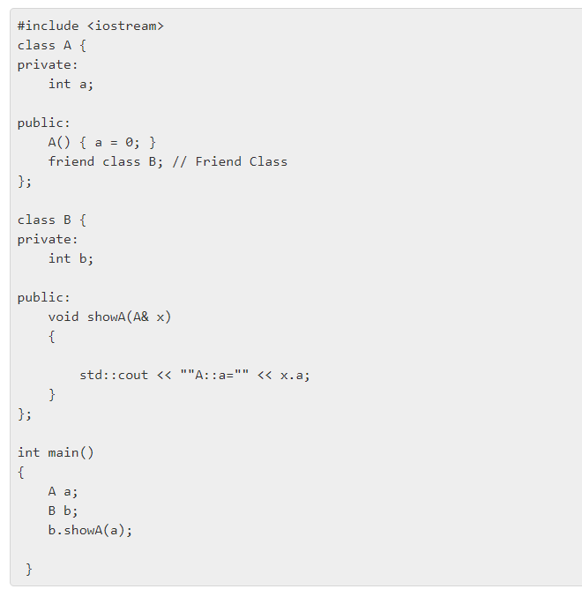
A. A::a=0
B. A
C. a=0
D. A::0

Slide 36
A. A::a=0
B. A
C. a=0
D. A::0

Slide 37
How many member functions in the following code?
class Box {
int capacity;
public:
void print();
friend void show();
bool compare();
friend bool lost();
};
A. 1
B. 2
C. 3
D. 4

Slide 38
How many member functions in the following code?
class Box {
int capacity;
public:
void print();
friend void show();
bool compare();
friend bool lost();
};
A. 1
B. 2
C. 3
D. 4

Slide 39
friend Functions and friend Classes
To declare a function as a friend of a class:
  Provide the function prototype in the class definition preceded by keyword friend.
To declare a class as a friend of another class:
  Place a declaration of the form
  friend class ClassTwo;
  in the definition of class ClassOne
All member functions of class ClassTwo are friends of class ClassOne.
Friendship is granted, not taken.
  For class B to be a friend of class A, class A must explicitly declare that class B is its friend.
Friendship relation is neither symmetric nor transitive
If class A is a friend of class B, and class B is a friend of class C, you cannot infer that class B is a friend of class A, that class C is a friend of class B, or that class A is a friend of class C.
It is possible to specify overloaded functions as friends of a class.
  Each overloaded function intended to be a friend must be explicitly declared as a friend of the class.

Slide 40
What is function????
Function is a self contained block of statements that perform a coherent task of some kind.
Every C++ program can be a thought of the collection of functions.
main( ) is also a function.

Slide 41
Types of Functions.
Library functions
  These are the in- -built functions of ‘C++ ’library.
  These are already defined in header files.
  e.g. Cout<<; is a function which is used to print at output. It is defined in ‘iostream.h ’ file .
User defined functions.
  Programmer can create their own function in C++ to perform specific task

Slide 42
Why use function?

Slide 43
Writing functions avoids rewriting of the same code again and again in the program.
Using function large programs can be reduced to smaller ones. It is easy to debug and find out the errors in it.
Using a function it becomes easier to write program to keep track of what they are doing.

Slide 44
//Function Declaration
retn_type func_name(data_type 1,data_type par2);
//Function Defination
rent_type func_name(data_type par1,data_type par2)
{
// body of the function
}
//Function Call
func_name(par1,par2);

Slide 45
Function prototype
A prototype statement helps the compiler to check the return type and arguments type of the function.
A prototype function consist of the functions return type, name and argument list.
Example
  int sum( int x, int y);

Slide 46
Example
#include<iostream.h>
#include<conio.h>
void sum(int, int); // function declaration
main()
{
int a, b;
cout<<“enter the two no”;
cin>>a>>b;
sum(a,b); // function calling
}
void sum( int x, int y) // function definition
{
int c=x+y;
cout<< “ sum is”<<c;
}

Slide 47
#include<conio.h>
int sum(int, int);
main()
{
int a=10,b=20;
int c=sum(a,b); /*actual arguments
Cout<<“sum is” << c;
getch();
}
int sum(int x, int y) /*formal arguments
{
int s;
s=x+y;
return(s); /*return value
}

Slide 48
Where does the execution of the program starts?
a) user-defined function
b) main function
c) void function
d) else function
Notes:
Ans b

Slide 49
What are mandatory parts in the function declaration?
a) return type, function name
b) return type, function name, parameters
c) parameters, function name
d) parameters, variables
Notes:
Ans a

Slide 50
What is the scope of the variable declared in the user defined function?
a) whole program
b) only inside the {} block
c) the main function
d) header section
Notes:
Ans b

Slide 51
Categories of functions
A function with no parameter and no return value
A function with parameter and no return value
A function with parameter and return value
A function without parameter and return value

Slide 52
A function with no parameter and no return value
#include<iostream>
using namespace std;
int main()
{
void print(); /*func declaration
cout<<“no parameter and no return value”;
print(); /*func calling
}
void print() /*func definition
{
for(int i=1;i<=30;i++)
{
cout<<“*”;
}
Cout<<“\n”;
}

Slide 53
A function with no parameter and no return value
There is no data transfer between calling and called function
The function is only executed and nothing is obtained
Such functions may be used to print some messages, draw stars etc

Slide 54
A function with parameter and no return value
#include<iostream>
using namespace std;
int main()
{
int a=10,b=20;
void mul(int,int);
mul(a,b); /*actual arguments
getch();
}
void mul(int x, int y) /*formal arguments
{
int s;
s=x*y;
cout<<“mul is” << s;
}

Slide 55
A function with parameter and return value
#include<iostream>
using namespace std;
int main()
{
int a=10,b=20,c;
int max(int,int);
c=max(a,b);
cout<<“greatest no is” <<c;
}
int max(int x, int y)
{
if(x>y)
return(x);
else
{
return(y);
}
}

Slide 56
A function without parameter and return value
#include<iostream>
using namespace std;
int main()
{
int a=10,b=20;
int sum();
int c=sum(); /*actual arguments
Cout<<“sum is”<< c;
}
int sum() /*formal arguments
{
int x=10,y=20;
return(x+y); /*return value
}

Slide 57
What is the default return type of a function ?
A. int
B. void
C. float
D. char
Notes:
Ans b

Slide 58
What is the output of this program?
#include < iostream >
using namespace std;
void fun(int x, int y)
{
x = 20;
y = 10;
}
int main()
{
int x = 10;
fun(x, x);
cout << x;
return 0;
}
A. 10
B. 20
C. compile time error
D. none of the mentioned
Notes:
Ans 10

Slide 59
#include < iostream >
using namespace std;
int fun(int x, int y)
{
x = 20;
y = 10;
return x;
}
int main()
{
int x = 10;
x=fun(x, x);
cout << x;
return 0;
}
A function with no parameter and no return value
A function with parameter and no return value
A function with parameter and return value
A function without parameter and return value
Notes:
Ans c

Slide 60
Argument passing techniques
Pass/or Call By Value
Pass/or Call By Pointer/Address
Pass/or Call By Reference

Slide 61
Call By Value
It is a default mechanism for argument passing.
Any changes made in the formal argument are not reflected back to actual argument, rather they remain local to the block which are lost once the control is returned back to calling program

Slide 62
EXAMPLE
int main()
{
int a=10,b=20;
void swap(int,int);
Cout<<“before function calling”<<a<<b;
swap(a,b);
Cout<<“after function calling”<<a<<b;
}

Slide 63
void swap(int x,int y)
{
int z;
z=x;
x=y;
y=z;
Cout<<“value is”<<x<<y;
}

Slide 64
Output:
before function calling a=10 b=20
value of x=20 and y= 10
after function calling a=10 b=20

Slide 65
Call By pointer/address
In this instead of passing value, address are passed.
Here formal arguments are pointers to the actual arguments
Hence change made in the argument are permanent.

Slide 66
int main()
{
int a=10 ,b=25;
void swap(int *,int *);
Cout<<“before function calling”<<a<<b;
swap(&a,&b);
Cout<<“after function calling”<<a<<b;
}

Slide 67
void swap(int *x,int *y)
{
int z;
z=*x;
*x=*y;
*y=z;
Cout<<“value is”<<*x<<*y;
}

Slide 68
Output:
before function calling a= 10 b= 25
value of x=25 and y=10
after function calling a=25 b= 10

Slide 69
Call By Reference(Using Reference Variables with Functions)
To create a second name for a variable in a program, you can generate an alias, or an alternate name
In C++ a variable that acts as an alias for another variable is called a reference variable, or simply a reference

Slide 70
Declaring Reference Variables
You declare a reference variable by placing a type and an ampersand in front of a variable name, as in double &cash; and assigning another variable of the same type to the reference variable
  double someMoney;
  double &cash = someMoney;
A reference variable refers to the same memory address as does a variable, and a pointer holds the memory address of a variable

Slide 71
EXAMPLE REFERENCE VARIABLE
int main()
{
int i=10;
int &j=i; // j is a reference variable of I
cout<<“value”<<i<<“\t”<<j;
j=20;
cout<<“modified value”<<i<<“\t”<<j;
}

Slide 72
Output:-
Value 10 10
modified value 20 20

Slide 73
PASS BY REFERENCE
int main()
{
int a=10 ,b=25;
void swap(int &a, int &b);
cout<<“before function calling”<<a<<b;
swap(a, b);
cout<<“after function calling”<<a<<b;
}

Slide 74
void swap(int &x, int &y)
{
int z;
z=x;
x=y;
y=z;
cout<<“value is”<<*x<<*y;
}

Slide 75
Output:
before function calling a= 10 b= 25
value of x=25 and y=10
after function calling a=25 b= 10

Slide 76
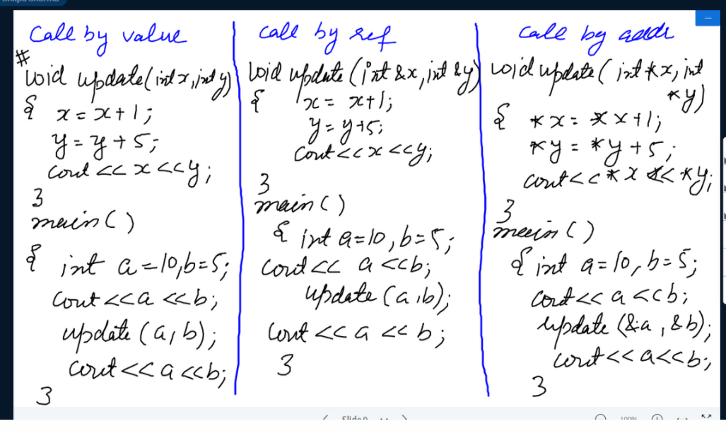

Slide 77
Find output:
#include<iostream>
using namespace std;
main()
{
int a=10,b=2;
void swap(int,int);
cout<<"before calling their values are "<<a<<" "<<b;
swap(a,b);
cout<<"\nafter calling their values are "<<a<<" "<<b;
}
void swap(int x, int y)
{
int z;
z=x;
x=y;
y=z;
}
a. before calling their values are 10 2
after calling their values are 10 2
b. before calling their values are 10 2
after calling their values are 2 10
c. before calling their values are 10 2
after calling their values are 10 10
d. before calling their values are 2 10
after calling their values are 10 2
Notes:
Ans a

Slide 78
Find output:
#include<iostream>
using namespace std;
main()
{
int a=10,b=2;
void swap(int *,int *);
cout<<"before calling their values are "<<a<<" "<<b;
swap(&a,&b);
cout<<"\nafter calling their values are "<<a<<" "<<b;
}
void swap(int *x, int *y)
{
int z;
z=*x;
*x=*y;
*y=z;
}
a. before calling their values are 10 2
after calling their values are 10 2
b. before calling their values are 10 2
after calling their values are 2 10
c. before calling their values are 10 2
after calling their values are 10 10
d. before calling their values are 2 10
after calling their values are 10 2
Notes:
Ans a

Slide 79
Recursion
When function call itself repeatedly ,until some specified condition is met then this process is called recursion.
It is useful for writing repetitive problems where each action is stated in terms of previous result.
The need of recursion arises if logic of the problem is such that the solution of the problem depends upon the repetition of certain set of statements with different input values an with a condition.

Slide 80
(EXAMPLE)Factorial using recursion
int main()
{
int rec(int);
int n, fact;
cout<<“enter the no.”;
cin>>n;
fact=rec(n);
cout<<“factorial is”<<fact;
}
int rec(int a)
{
int b;
if(a<=1)
{
return(1);
}
else
{
b=a*rec(a-1);
return(b);
}}

Slide 81
Advantages of recursion
It make program code compact which is easier to write and understand.
It is used with the data structures such as linklist, stack, queues etc.
It is useful if a solution to a problem is in repetitive form.
The compact code in a recursion simplifies the compilation as less number of lines need to be compiled.

Slide 82
Disadvantages
Consume more storage space as recursion calls and automatic variables are stored in a stack.
It is less efficient in comparison to normal program in case of speed and execution time
Special care need to be taken for stopping condition in a recursion function
If the recursion calls are not checked ,the computer may run out of memory.

Slide 83
Default arguments
In the function prototype declaration , the default values are given. Whenever a call is made to function without specifying an argument , the program will automatically assign values to the parameters from the default function prototype.
Default arguments facilitate easy development and maintenance of programs.

Slide 84
#include<iostream>
void sum(int x=10, int y=20);
main()
{
int a, b;
sum();
}
void sum(int a1=10,int a2=20)
{
temp= a1+a2;
}

Slide 85
Default Arguments
#include <iostream>
using namespace std;
void display(char = '*', int = 1);
int main()
{
cout<<"No argument passed:\n";
display();
cout<<"\n\nFirst argument passed:\n";
display('#');
cout<<"\n\nBoth argument passed:\n";
display('$', 5);
return 0;
}
void display(char c, int n){
for(int i = 1; i <=n; ++i) {
cout<<c;
}
cout<<endl;
}

Slide 86
If the user didn't supply the user value means, then what value will it take?
A. default value
B. rise an error
C. both a & b
D. none of the mentioned
Notes:
Ans a

Slide 87
Where does the default parameter can be placed by the user?
A. leftmost
B. rightmost
C. both a & b
D. none of the mentioned
Notes:
Ans b

Slide 88
Which value will it take when both user and default values are given?
A. user value
B. default value
C. custom value
D. none of the mentioned
Notes:
Ans a

Slide 89
SCOPE RULES
Local Variable
Global variable
Local Variables are defined inside the function body or in a compound statement. The scope of these variables are inside the function where they are defined.
Eg: int fact (int n)
{
Int i, fact, j; // i, j are local variables.
-----
----
}

Slide 90
Global variables are those variables whose scope is available through out the program.

Slide 91
int x;
main()
{
int y=0;
{ int y=20;
cout<<x<<y;
x++;y++;
{ int y=20;
cout<<x<<y;
}}
cout<<x<<y;
}
Notes:
Discuss local and global variables ..

Slide 92
FUNCTION OVERLOADING

Slide 93
Overloading in C++
What is overloading
– Overloading means assigning multiple
meanings to a function name or operator
symbol
– It allows multiple definitions of a function with the same name, but different signatures.
C++ supports
– Function overloading
– Operator overloading

Slide 94
Why is Overloading Useful?
Function overloading allows functions that
conceptually perform the same task on
objects of different types to be given the
same name.
Operator overloading provides a convenient
notation for manipulating user-defined
objects with conventional operators.

Slide 95
Function Overloading
Is the process of using the same name for two or more functions
Requires each redefinition of a function to use a different function signature that is:
  different types of parameters,
  or sequence of parameters,
  or number of parameters
Is used so that a programmer does not have to remember multiple function names

Slide 96
Void sum(int,int);
Void sum(double,double);
Void sum(char,char);
main()
{
int a=10,b=20 ;
double c=7.52,d=8.14;
char e=‘a’ , f=‘b’ ;
sum(a,b);
sum(c,d);
sum(e,f);
}
void sum(int x, int y)
{
cout<<“\n sum of integers are”<<x+y;
}
void sum(double x, double y)
{
cout<<“\n sum of two floating no are”<<x+y;
}
void sum(char x, char y)
{
cout<<“\n sum of characters are”<<x+y;
}

Slide 97
When will we use the function overloading?
A. same function name but different number of arguments
B. different function name but same number of arguments
C. same function name but same number of arguments
D. different function name but different number of arguments
Notes:
Ans a

Slide 98
Overloaded functions are
A. Very long functions that can hardly run
B. One function containing another one or more functions inside it.
C. Two or more functions with the same name but different number of parameters or type.
Notes:
Ans c

Slide 99
When we want our private data to be shared by a non member function
Then
Basically, we declare something as a friend, you give it access to your private data members.
Single functions or entire classes may be declared as friends of a class.

Slide 100
Friend function
A Friend function is a non-member function of the class that has been granted access to all private members of the class.
We simply declare the function within the class by a prefixing its declaration with keyword friend.
Function definition must not use keyword friend.
Definition of friend function is specified outside the class body and is not treated as a part of the class.
The major difference b/w member function and friend function is that the member function is accessed through the object while friend function requires object to be passed as parameter.

Slide 101
Syntax:
class ABC
{
………….
public:
friend void xyz(object of class);
};

Slide 102
Friend function characterstics
It is not in scope of class.
It cannot be called using object of that class.
It can be invoked like a normal function.
It should use a dot operator for accessing members.
It can be public or private.
It has objects as arguments.
Perhaps the most common use of friend functions is overloading << and >> for I/O.

Slide 103
class sample
{
int a;
int b;
public:
void setval(){ a=25,b=40}
friend float mean(sample s);
};
float mean(sample s)
{ return (s.a+s.b)/2.0;
}
void main()
{ sample X;
X.setval();
cout<<mean(X);
}

Slide 104
Friend class
In previous section of class we declared only one function as a friend of another class. but it is possible that all member of the one class can be friend of another class. This is friend class.

Slide 105
Friends (a few gory details)
Friendship is not inherited, transitive, or reciprocal.
  Derived classes don’t receive the privileges of friendship (more on this when we get to inheritance in a few classes)
  The privileges of friendship aren’t transitive. If class A declares class B as a friend, and class B declares class C as a friend, class C doesn’t necessarily have any special access rights to class A.
  If class A declares class B as a friend (so class B can see class A’s private members), class A is not automatically a friend of class B (so class A cannot necessarily see the private data members of class B).

Slide 106
class demo1
{
public:
void display(demo d1)
{
cout<<“x is=”d1.x;
cout<<“y is=”d1.y;
}
};
class demo
{
private:
int x,y;
public:
demo(int a,int b)
{
x=a;
y=b;
}
friend class demo1;
};
main()
{
demo d2(10,40);
demo1 f1;
f1.display(d2);
}

Slide 107
#include<iostream>
using namespace std;
class A
{
int a,b;
public:
void output()
{
cout<<a<<endl<<b;
}
friend class B;
};
class B
{
int c;
public:
void take(A &obj)
{
obj.a=23;
obj.b=24;
}
};
main()
{
A obj;
B obj1;
obj1.take(obj);
obj.output();
}
Output:
A: 23
24
B. A: 24
24
c. A: 23
23
D: 24
23

Slide 109



